Slide 1
Machine Learning for Neuroscience
Summary and overview
Payam Barnaghi
Department of Brain Sciences
Imperial College London
January 2023
Notes:
1

Slide 2
Data and representations
CCXVI divided by VI?
216/6?
via: Goodfellow et al., Deep learning

Slide 3
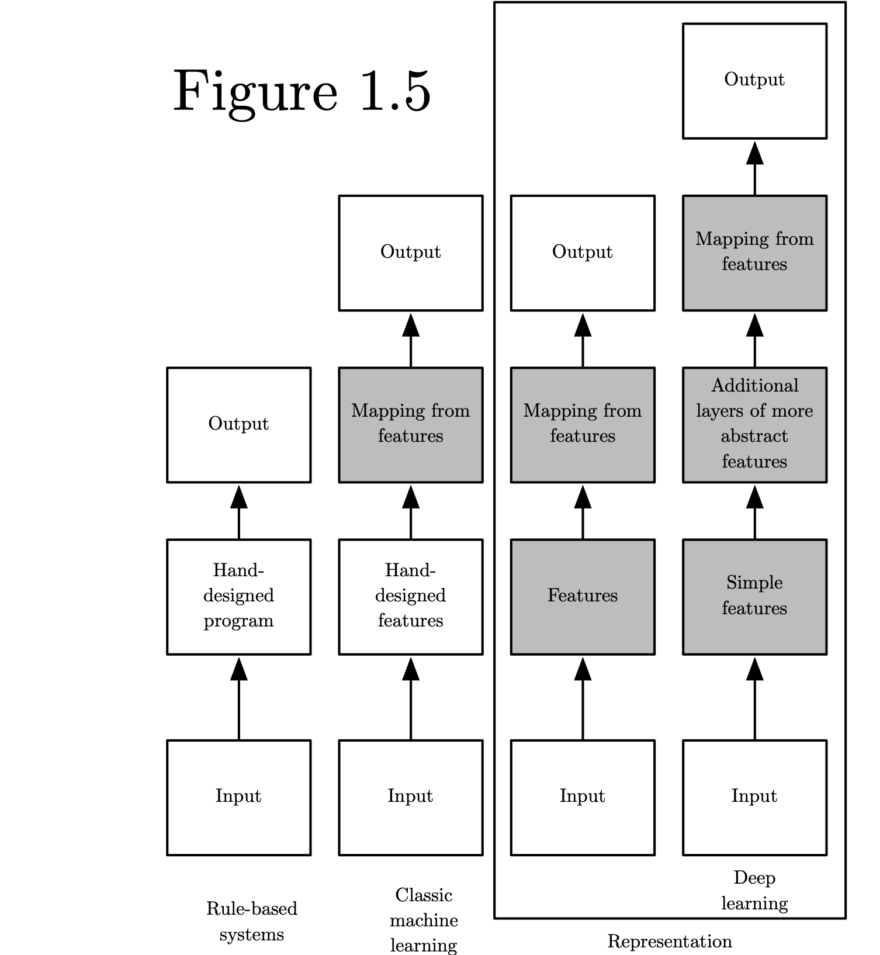
Categories of learning and intelligent systems
Source: Deep Learning, Ian Goodfellow et al, MIT press.

Slide 4
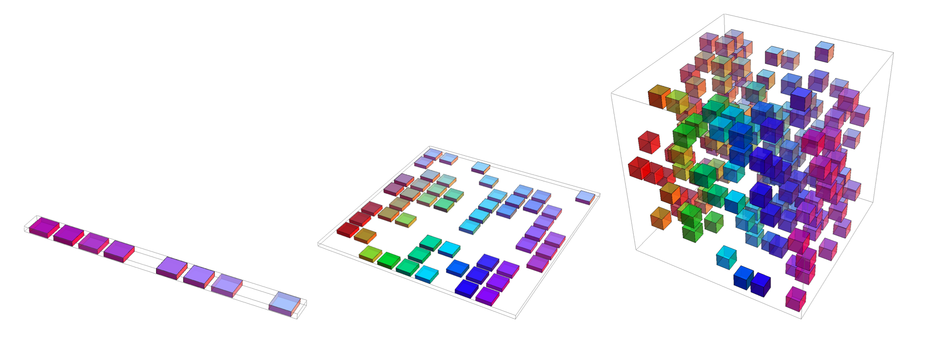
Curse of dimensionality
Overall, for d dimensions with v values we need O(v^{d}) regions and examples
Source: Deep Learning, Ian Goodfellow et al, MIT press.

Slide 5
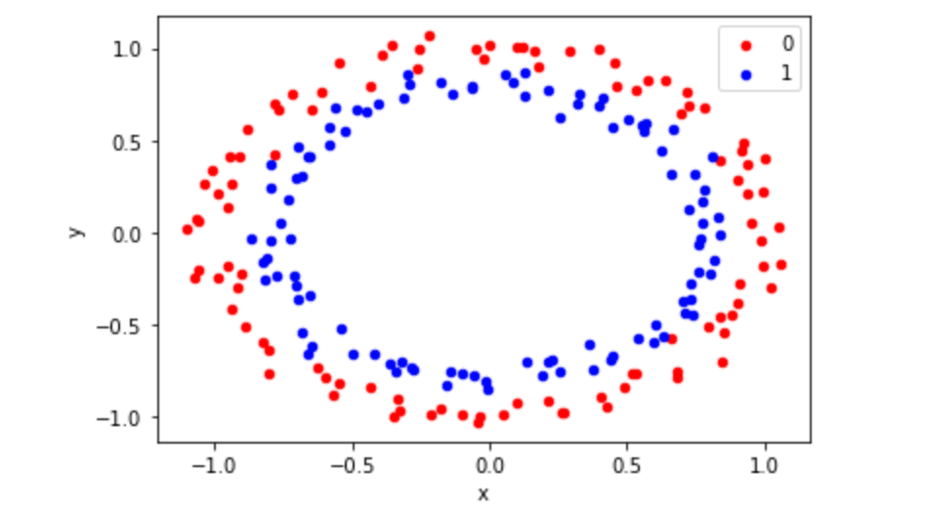
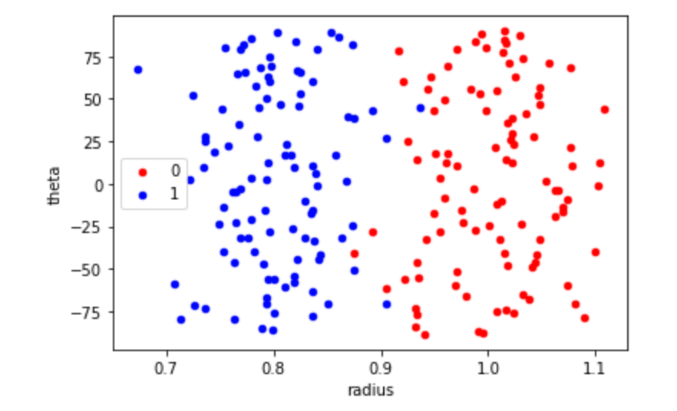
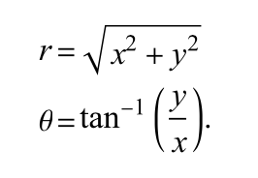
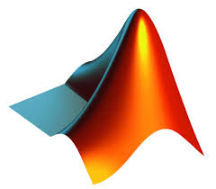

Data/sample representation
(x,y)
<Code>
https://github.com/PBarnaghi/Basic-ML-Code/

Slide 6
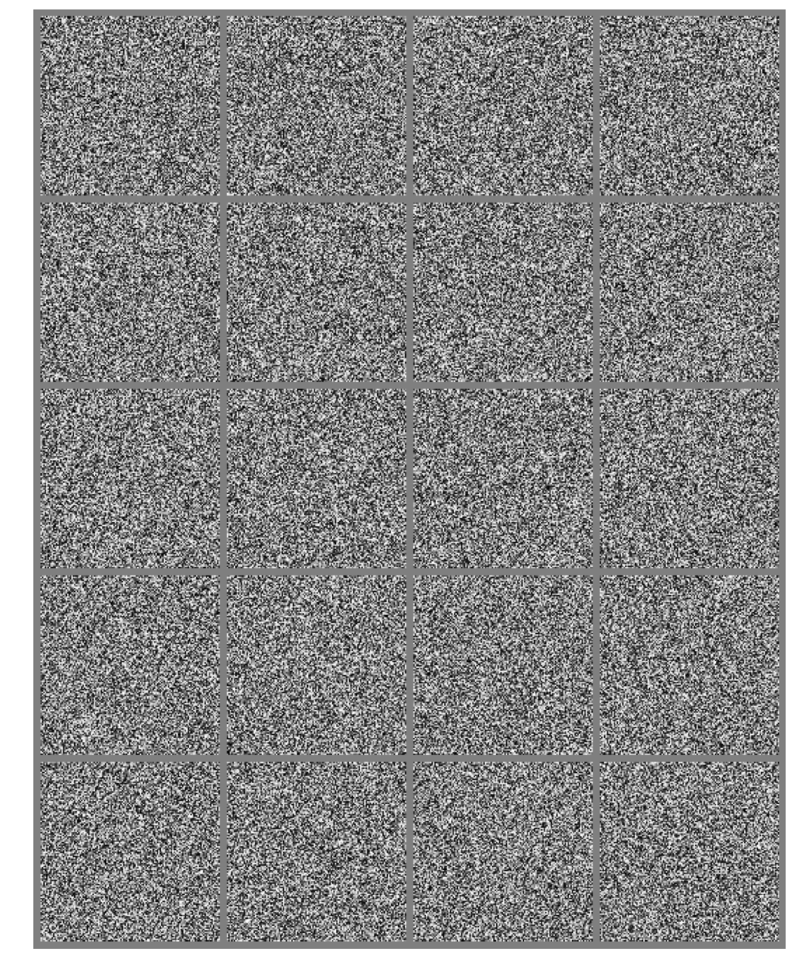
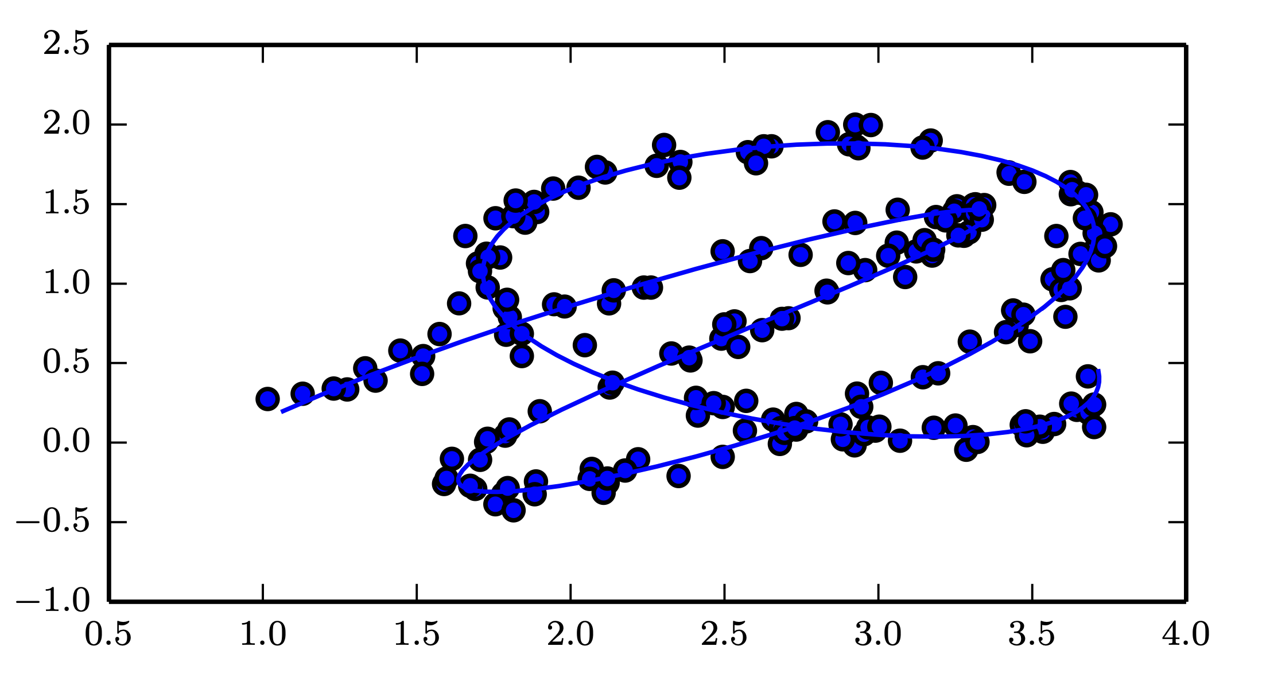
Manifold learning
Source: Deep Learning, Ian Goodfellow et al, MIT press.

Slide 7
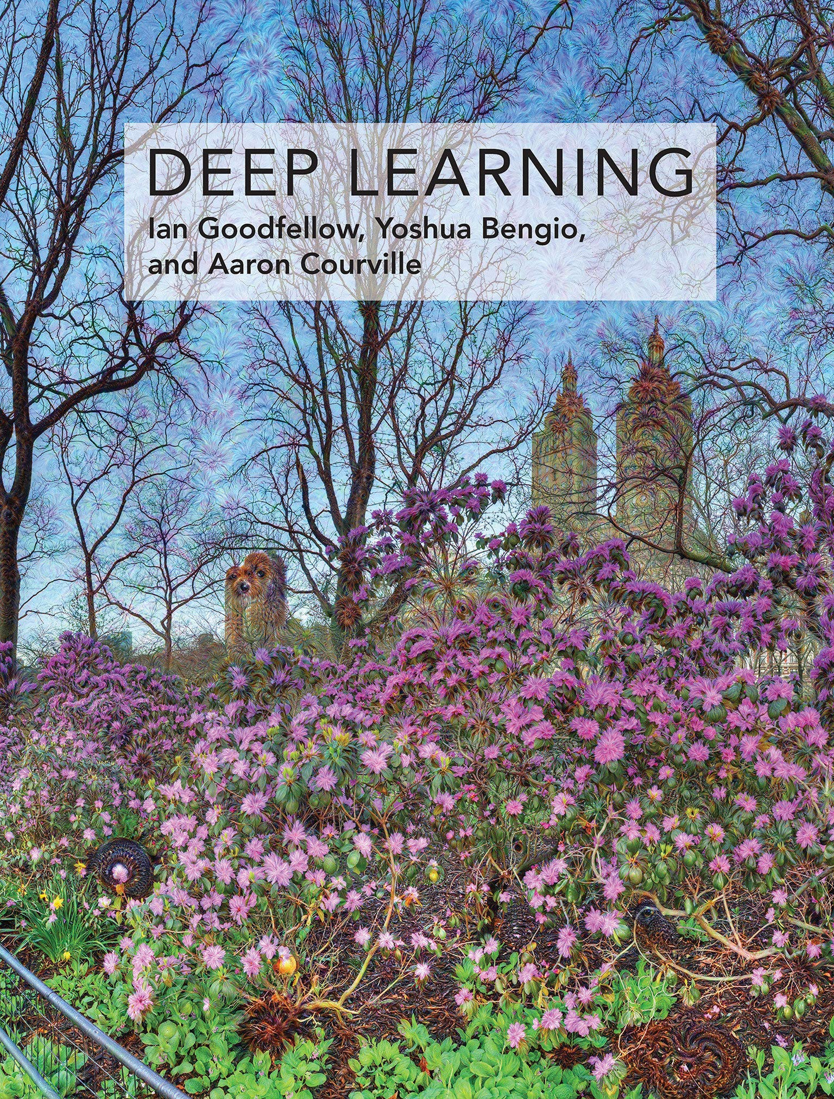
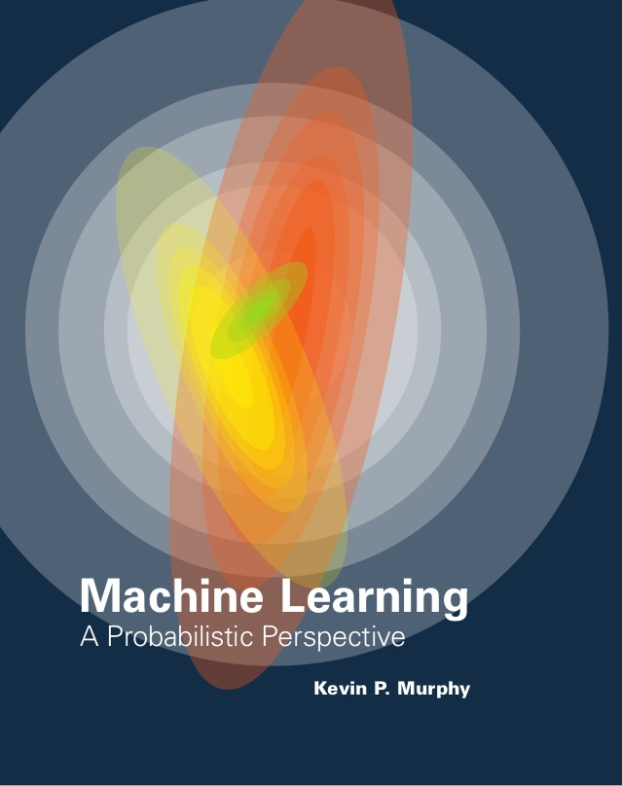
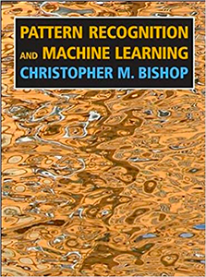
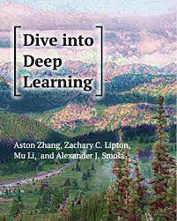
Reference and sources
Deep Learning
Goodfellow et al., MIT Press
Machine Learning: A Probabilistic Perspective
Kevin P. Murphy, MIT Press
Pattern Recognition and Machine Learning
Christopher M. Bishop
Dive into Deep Learning
Aston Zhang et al.
Preprints:
Deep learning: https://www.deeplearningbook.org
Machine learning a probabilistic perspective: https://probml.github.io/pml-book/
Dive into deep learning, https://d2l.ai/index.html

Slide 8
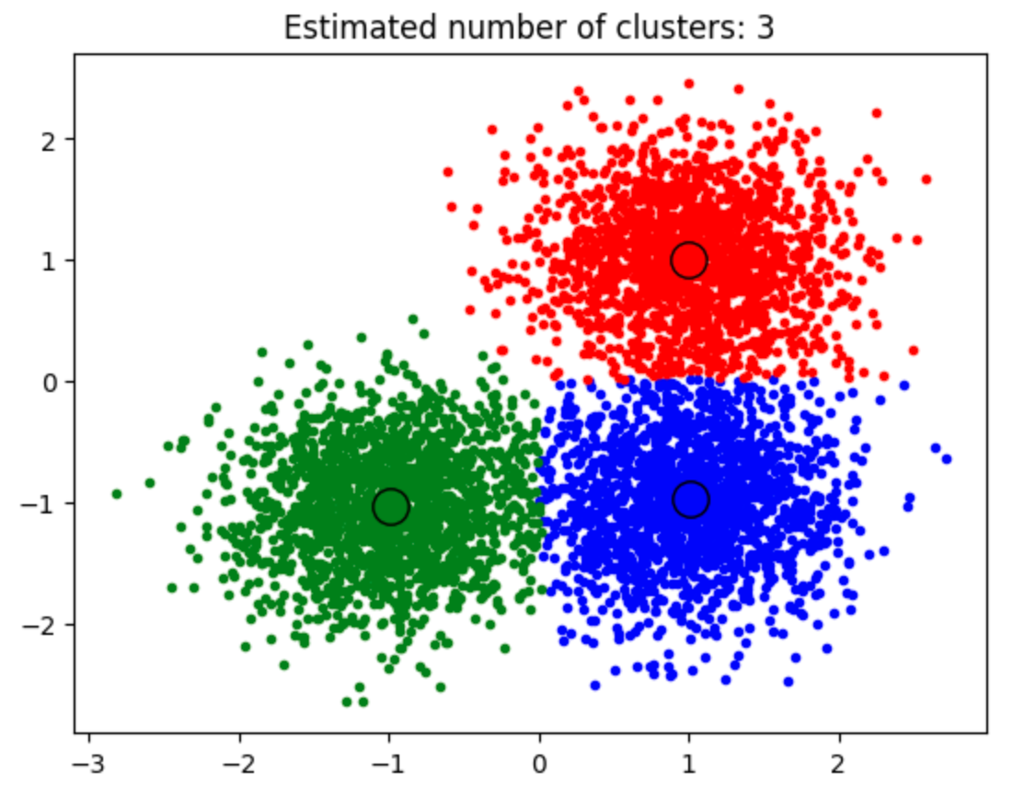
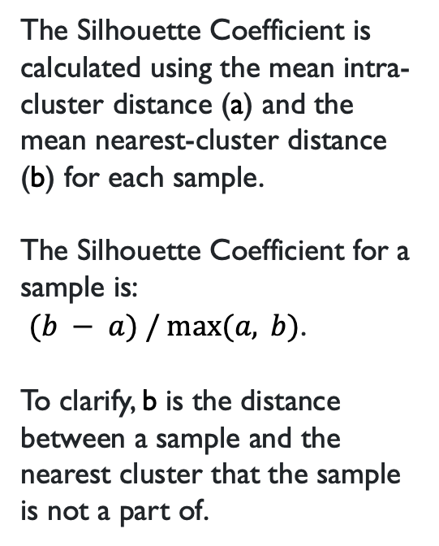
K-means
The Silhouette Coefficient is calculated using the mean intra-cluster distance (a) and the mean nearest-cluster distance (b) for each sample.
The Silhouette Coefficient for a sample is:
$(b − a) / max⁡(a, b)$.
To clarify, b is the distance between a sample and the nearest cluster that the sample is not a part of.
Source: https://scikit-learn.org/stable/modules/generated/sklearn.metrics.silhouette_score.html

Slide 9
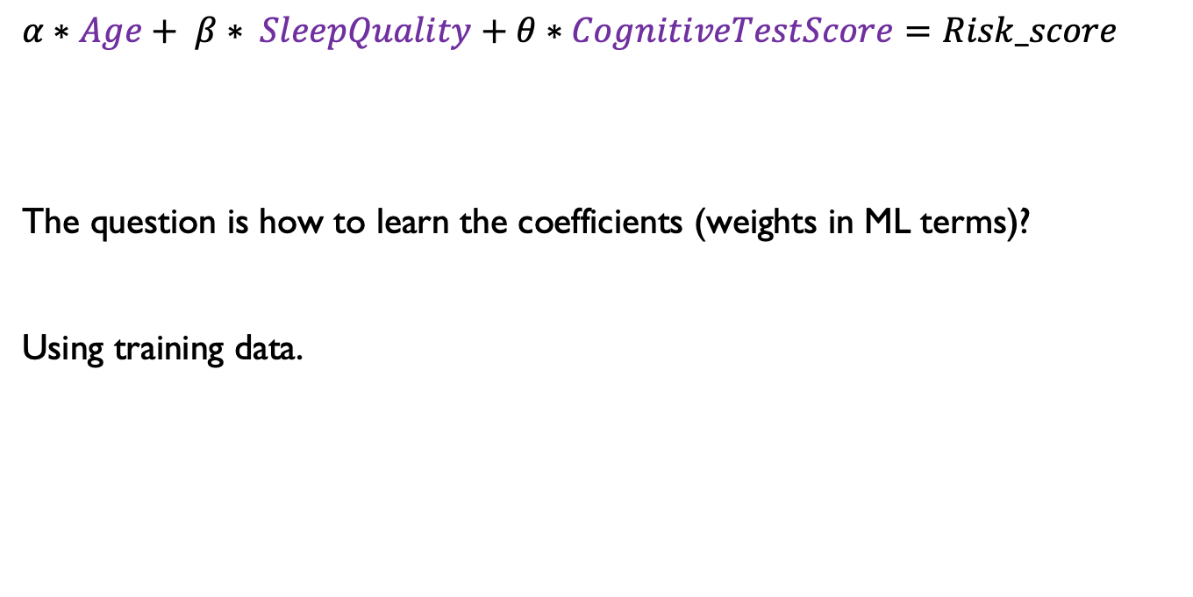
Linear models - training
$α∗Age+ β∗ SleepQuality+θ∗CognitiveTestScore=Risk_score$
The question is how to learn the coefficients (weights in ML terms)?
Using training data.

Slide 10
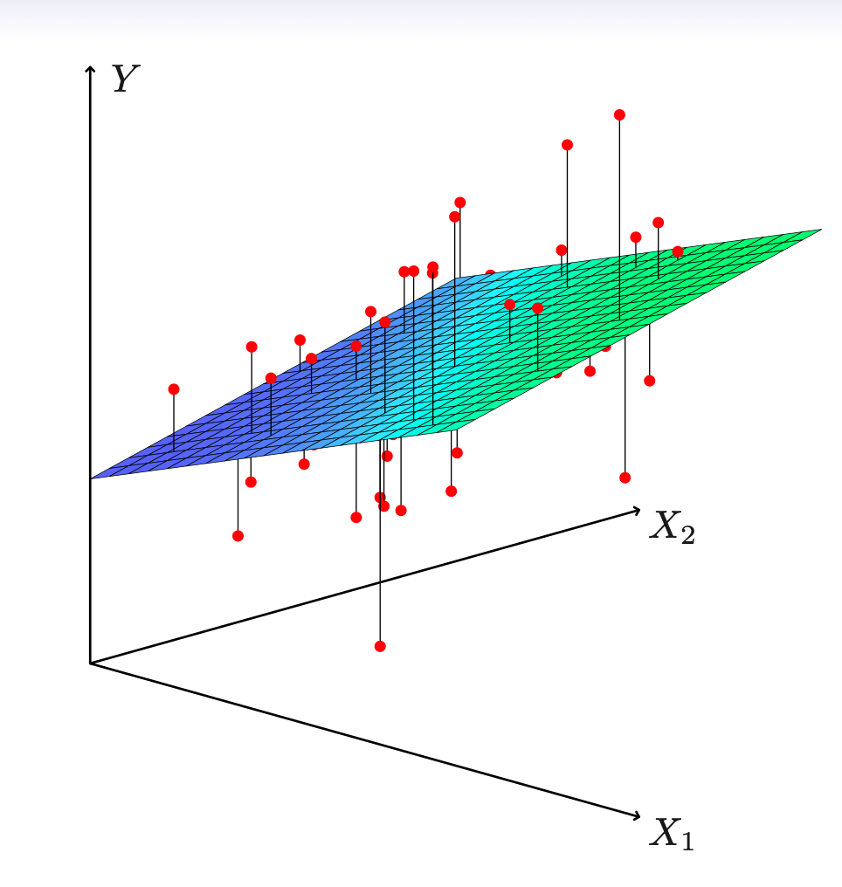
Estimation and prediction for multiple regression

Slide 11
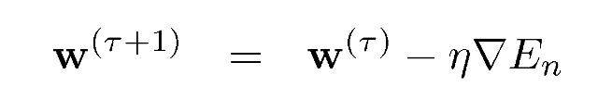
Sequential learning – Stochastic Gradient Descent*
The input data is considered one at a time.
We can use stochastic (sequential) gradient descent to learn the parameters of a multiparameter regression:
This is also known as the least-mean-squares (LMS) algorithm.
More on this topic later – in the neural networks section.

Slide 12
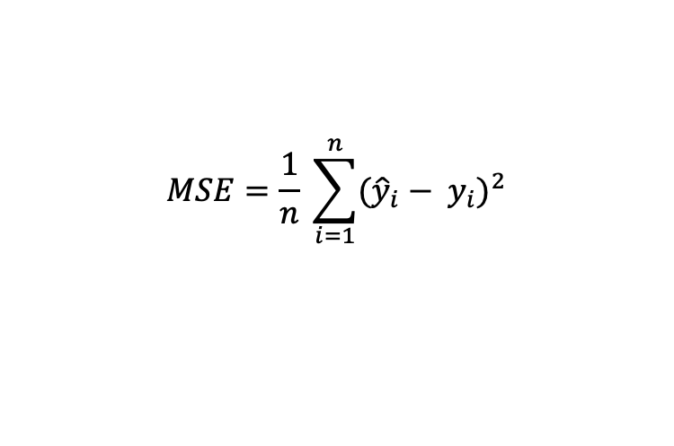
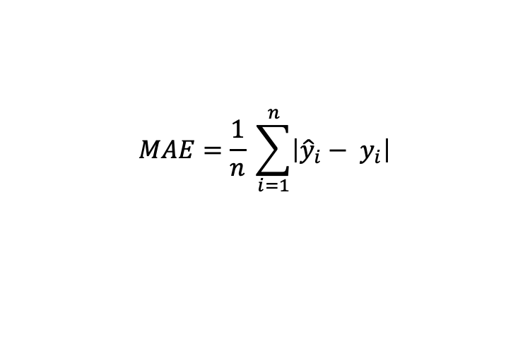
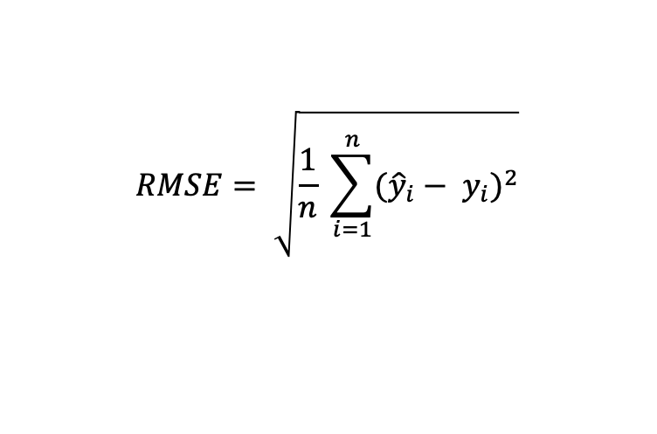
How to evaluate your LR model
$$MAE=\frac{1}{n} \sum_{i=1}^{n}{\left|{\hat{y}}_{i}− y_{i}\right|}$$
Mean Absolute Error (MAE)
Mean Squared Error (MSE)
Root Mean Squared Error (RMSE)
$$MSE=\frac{1}{n} \sum_{i=1}^{n}{{({\hat{y}}_{i}− y_{i})}^{2}}$$
$$RMSE= \sqrt{\frac{1}{n} \sum_{i=1}^{n}{{({\hat{y}}_{i}− y_{i})}^{2}}}$$

Slide 13
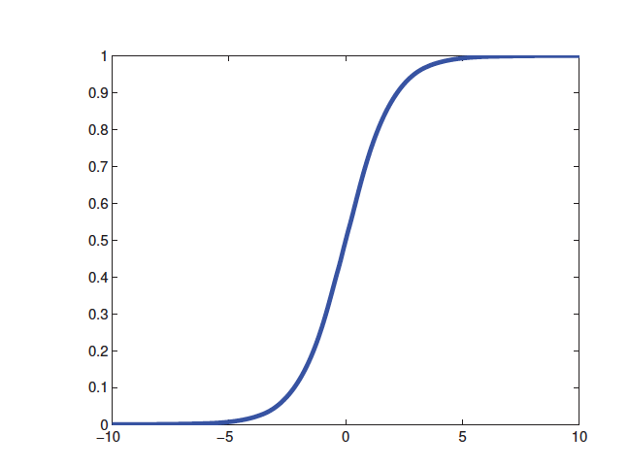
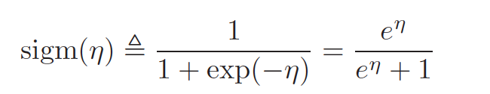
Logistic regression
The process of applying linear combination of the inputs, as before, but then we pass this through a logistics function is called logistic regression due to its similarity to linear regression (although it is a form of classification, not regression!).

Slide 14
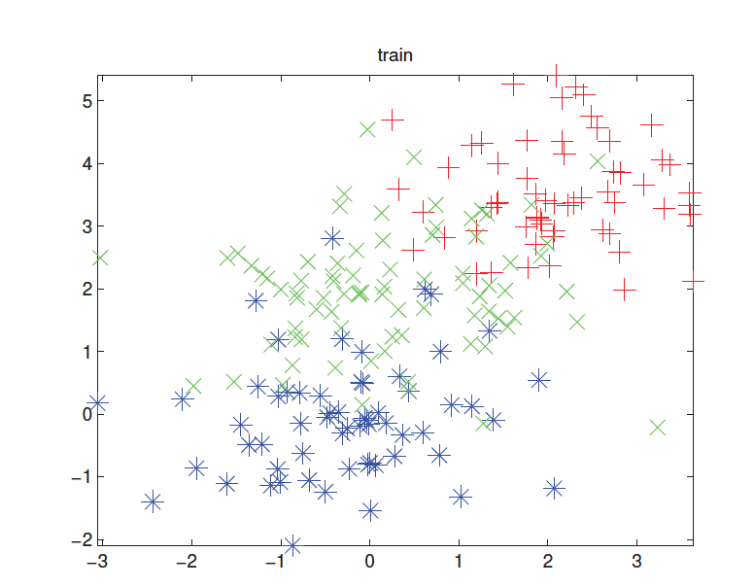
K-nearest neighbours - example

Slide 15
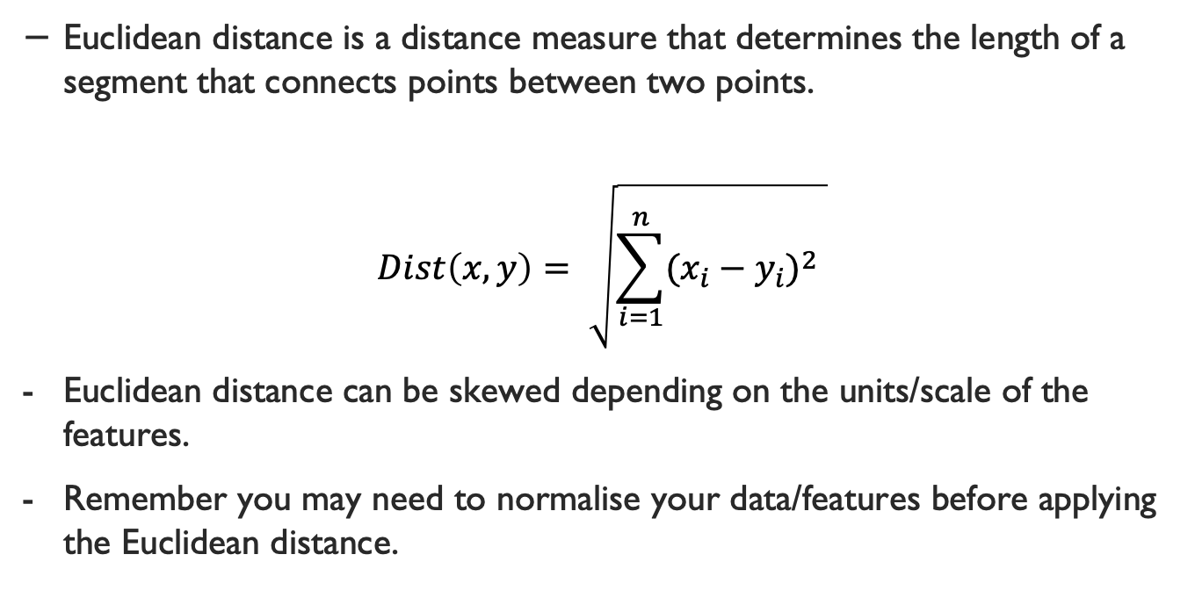
Euclidean distance
Euclidean distance is a distance measure that determines the length of a segment that connects points between two points.
$$Dist\left(x,y\right)= \sqrt{\sum_{i=1}^{n}{{(x_{i}−y_{i})}^{2} }}$$
Euclidean distance can be skewed depending on the units/scale of the features.
Remember you may need to normalise your data/features before applying the Euclidean distance.

Slide 16
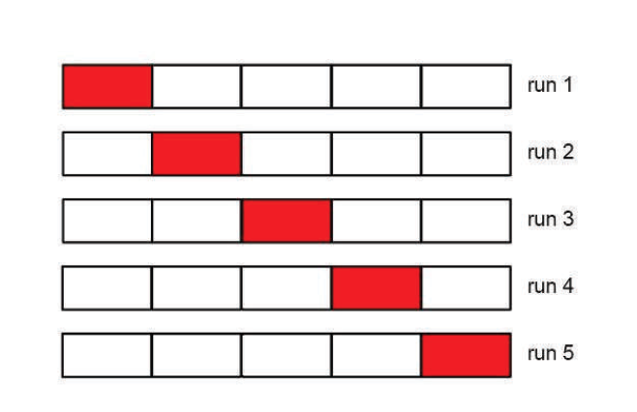
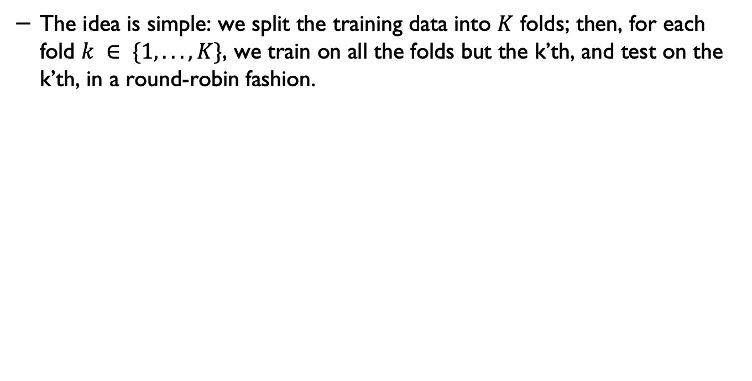
Cross validation
The idea is simple: we split the training data into $K$ folds; then, for each fold $k ∈ \{1, . . . , K\}$, we train on all the folds but the k’th, and test on the k’th, in a round-robin fashion.

Slide 17
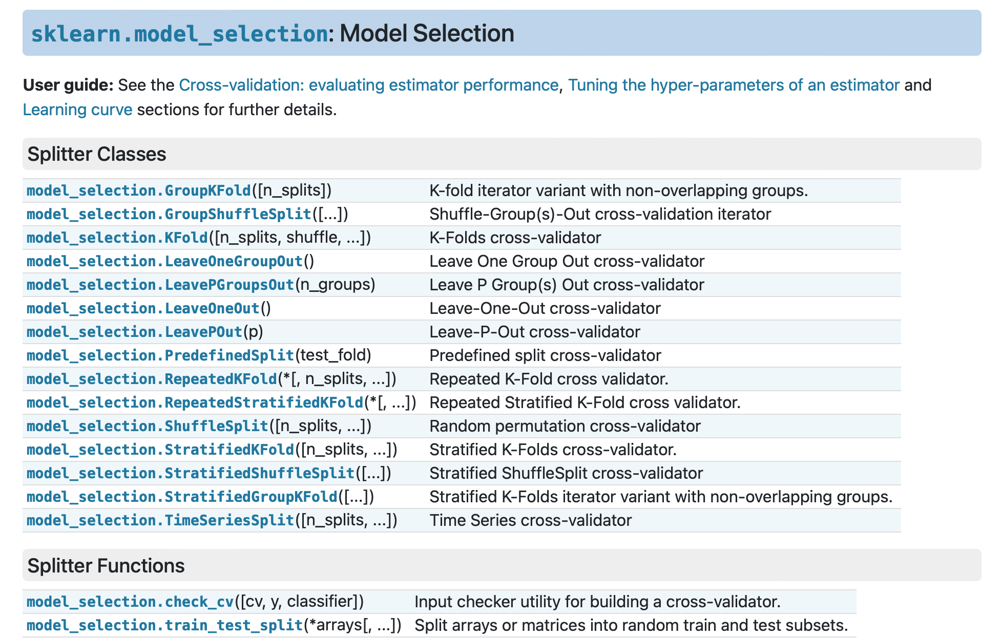
Cross validation - in Scikit learn
https://scikit-learn.org/stable/modules/cross_validation.html#cross-validation

Slide 18
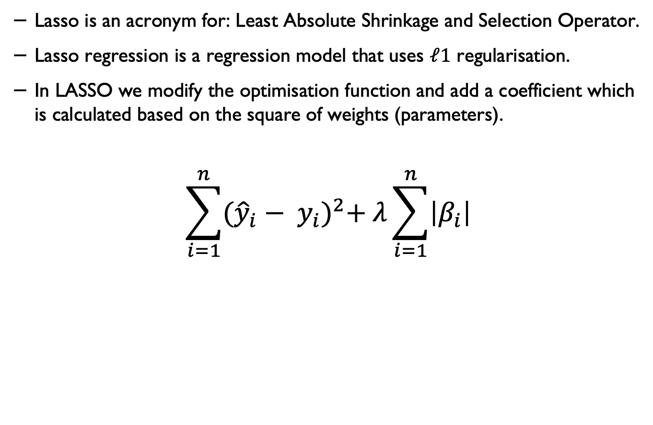
L1 Regularisation (Lasso)*
Lasso is an acronym for: Least Absolute Shrinkage and Selection Operator.
Lasso regression is a regression model that uses $ℓ1$ regularisation.
In LASSO we modify the optimisation function and add a coefficient which is calculated based on the square of weights (parameters).
$$\sum_{i=1}^{n}{{({\hat{y}}_{i}− y_{i})}^{2}+ λ\sum_{i=1}^{n}{\left|β_{i}\right|}}$$

Slide 19
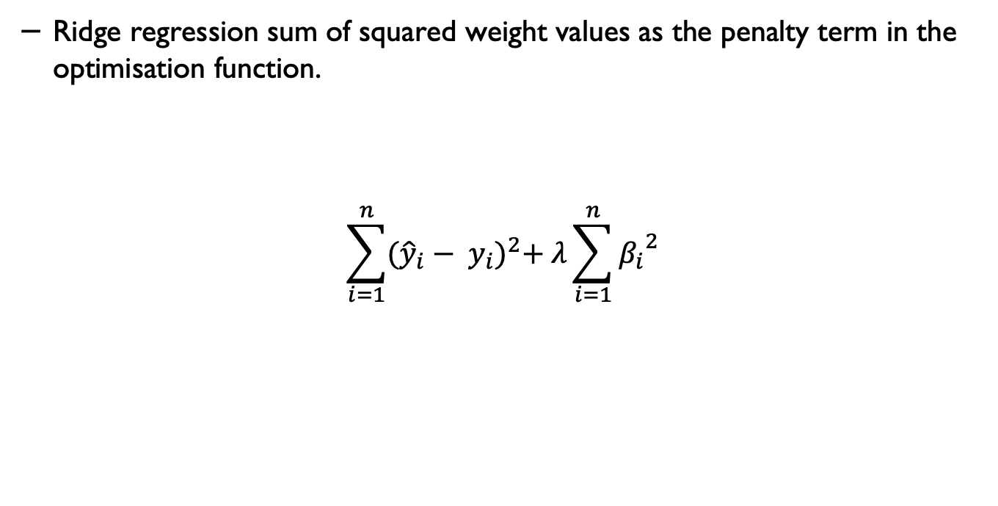
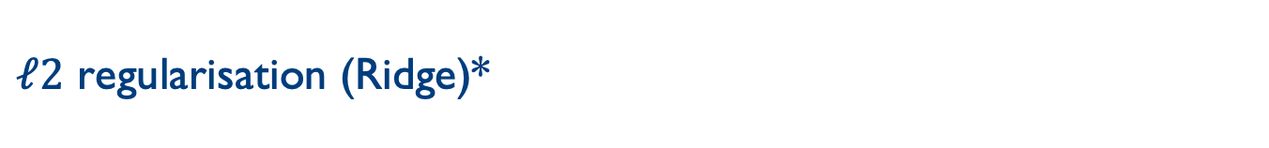
$ℓ2$ regularisation (Ridge)*
Ridge regression sum of squared weight values as the penalty term in the optimisation function.
$$\sum_{i=1}^{n}{{({\hat{y}}_{i}− y_{i})}^{2}+ λ\sum_{i=1}^{n}{{β_{i}}^{2}}}$$

Slide 20
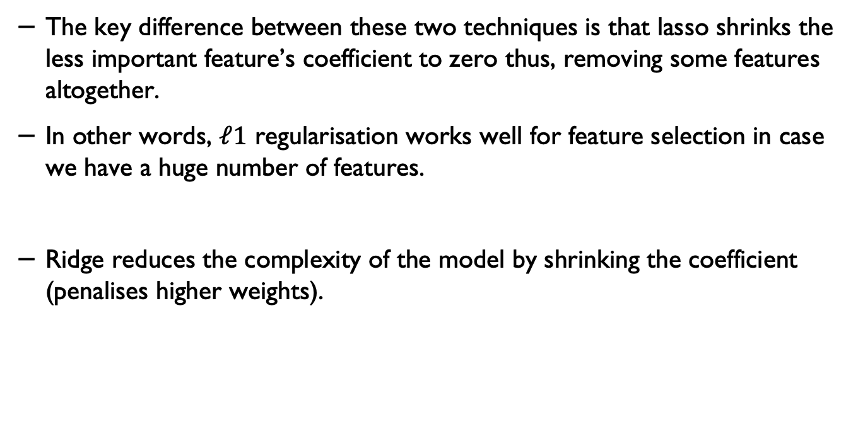
Lasso and Ridge
The key difference between these two techniques is that lasso shrinks the less important feature’s coefficient to zero thus, removing some features altogether.
In other words, $ℓ1$ regularisation works well for feature selection in case we have a huge number of features.
Ridge reduces the complexity of the model by shrinking the coefficient (penalises higher weights).

Slide 21
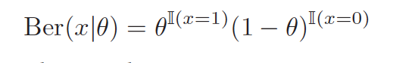
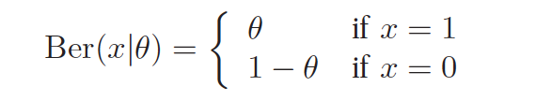
Bernoulli
Suppose we toss a coin only once. Let $X ∈ \{0, 1\}$be a binary random variable, with probability of “success” or “heads” of θ.
We say that X has a Bernoulli distribution. This is written as $X ∼ Ber(θ)$, where the pmf is defined as

Slide 22
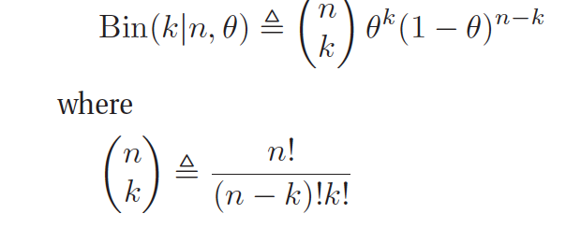
Binomial distribution
If we toss a coin n times and want to determine the probability of $k$ heads (probability of a head is θ).
$$and n!=n ∗\left(n−1\right) ∗\left(n−2\right)∗ …∗1$$

Slide 23
Bayes rule
Likelihood
Prior
Posterior
$$p\left(A | B\right)=\frac{p\left(B | A\right). p(A)}{p(B)}$$
Marginalisation

Slide 24
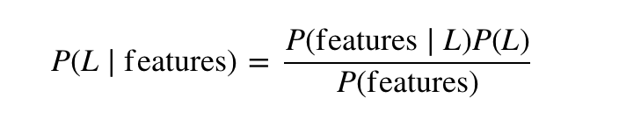
Naïve Bayes
We call it Naïve because it assumes that all the features are independent. In practice this is not always true – but this assumptions allows us to apply the Bayesian theorem:

Slide 25
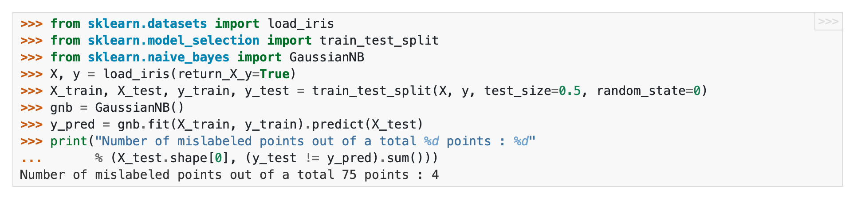
Naïve Bayes in scikit-learn
Source: https://scikit-learn.org/stable/modules/naive_bayes.html

Slide 26
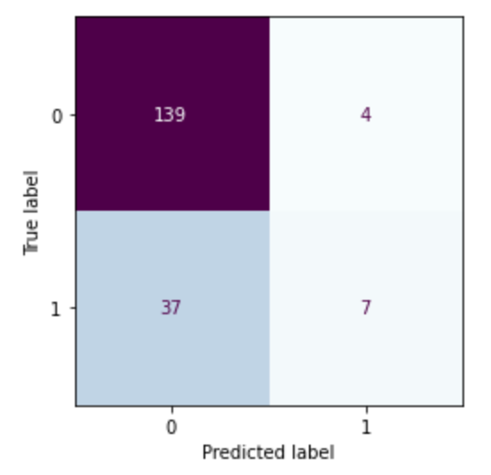
Confusion matrix

Slide 27
All in one place
$$Precision= \frac{TP}{TP+FP}$$
$$F1=2 × \frac{Precision × Recall}{Precision +Recall}$$
$$Recall= \frac{TP}{TP+FN}$$
$$Recall= \frac{TP+TN}{TP+TN+FP+FN}$$
$$Sensetivity= \frac{TP}{TP+FN}$$
$$Specificity= \frac{TN}{TN+FP}$$

Slide 28
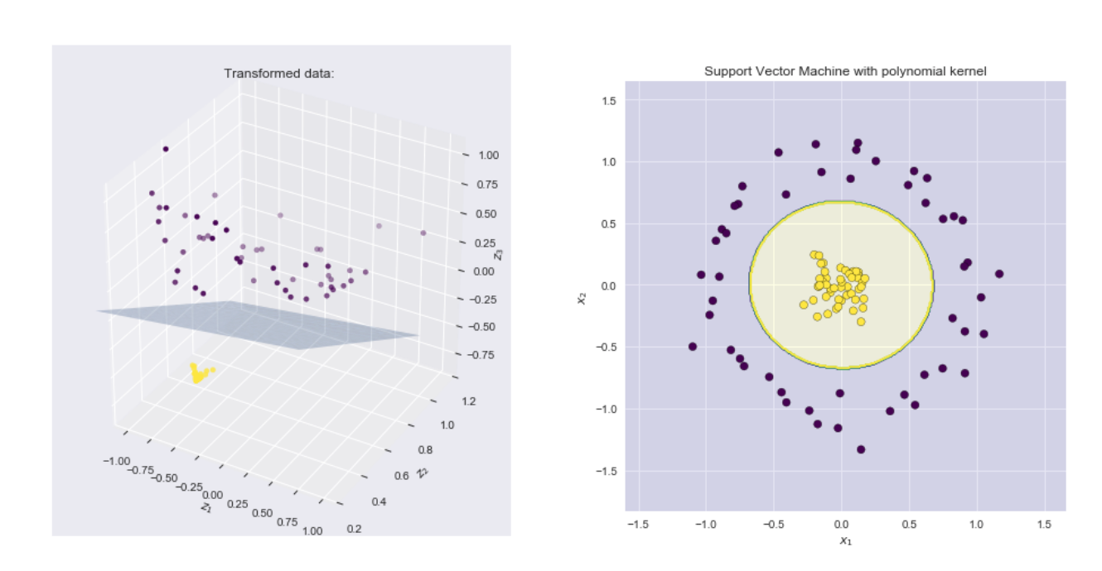
Example – applying polynomial kernel
Source: https://xavierbourretsicotte.github.io/Kernel_feature_map.html

Slide 29
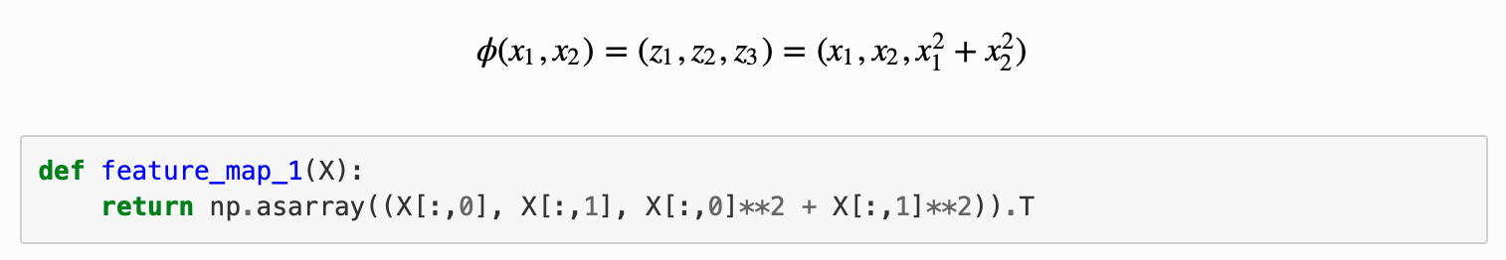
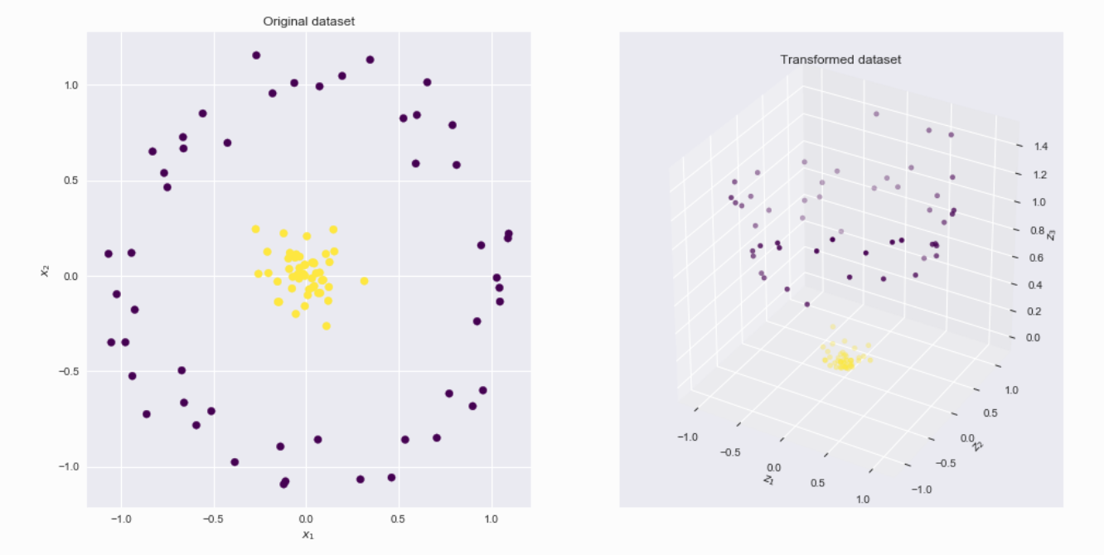
A polynomial kernel
Source: https://xavierbourretsicotte.github.io/Kernel_feature_map.html

Slide 30
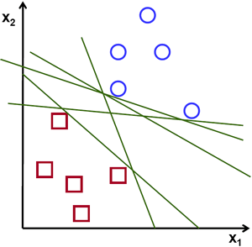
SVM Example
Source: https://vovkos.github.io/doxyrest-showcase/opencv/sphinx_rtd_theme/page_tutorial_introduction_to_svm.html

Slide 31

Example: SVM for a linearly separable set of 2d-points
Source: https://vovkos.github.io/doxyrest-showcase/opencv/sphinx_rtd_theme/page_tutorial_introduction_to_svm.html

Slide 32
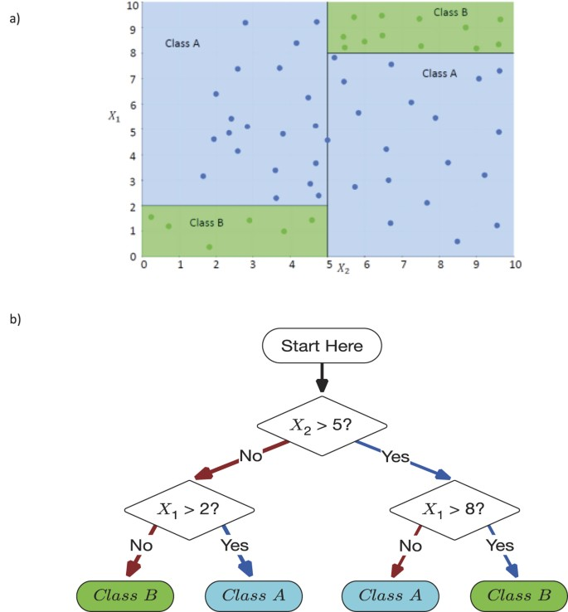
Decision Making Using DTs
Source: Valdes, G., Luna, J., Eaton, E. et al. MediBoost: a Patient Stratification Tool for Interpretable Decision Making in the Era of Precision Medicine. Sci Rep 6, 37854 (2016). https://doi.org/10.1038/srep37854

Slide 33
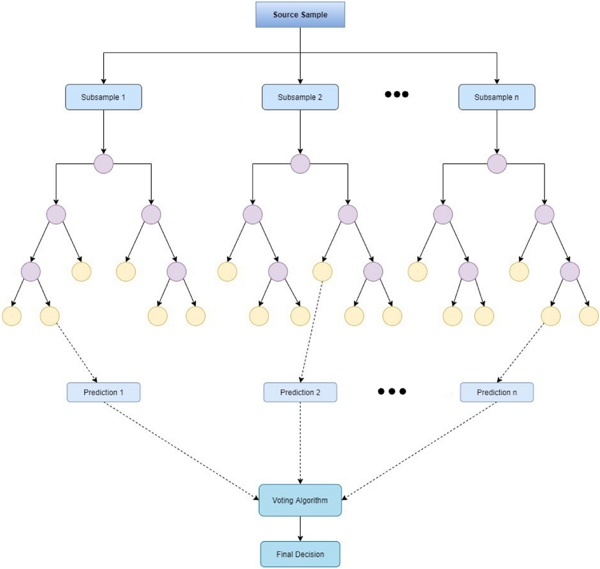
Structure of Random Forests
Source: Malebary, S.J., Khan, Y.D. Evaluating machine learning methodologies for identification of cancer driver genes. Sci Rep 11, 12281 (2021). https://doi.org/10.1038/s41598-021-91656-8

Slide 34
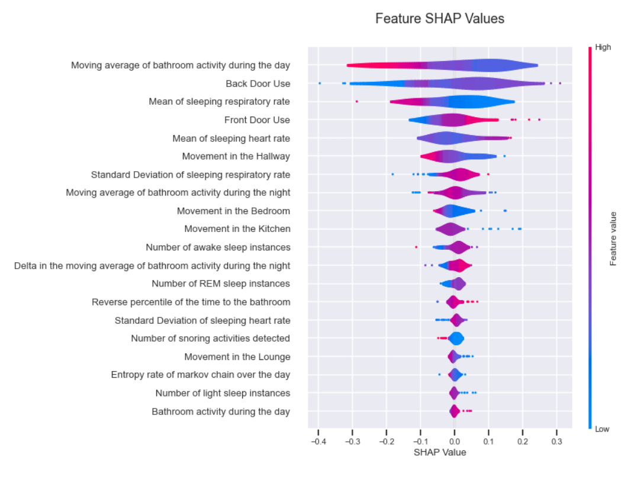
SHAP
SHAP (SHapley Additive exPlanations) is a game theoretic approach to explain the output of any machine learning model.
It connects optimal credit allocation with local explanations using the classic Shapley values from game theory and their related extensions.
See: https://github.com/slundberg/shap

Slide 35
NN with an activation function
b
$$x_{1}$$
$$w_{1}$$
$$w_{2}$$
$$\sum_{i=0}^{n}{w_{i}{∗x}_{i}}+b$$
$$x_{2}$$
y
$$w_{3}$$
$$x_{3}$$
$$f\left(\sum_{i=0}^{n}{w_{i}{∗x}_{i}}+b\right)$$

Slide 36
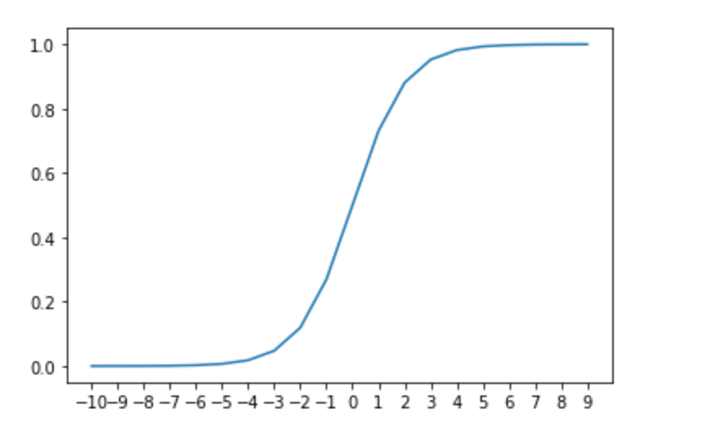
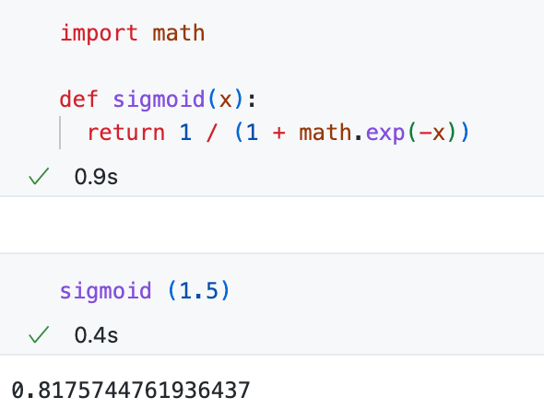
Sigmoid function
$$sigmoid\left(x\right)= \frac{1}{1+e^{−x}}$$
$$sigmoid\left(x\right)= \frac{1}{1+exp⁡(−x)}$$

Slide 37
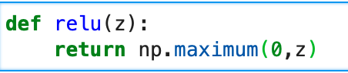
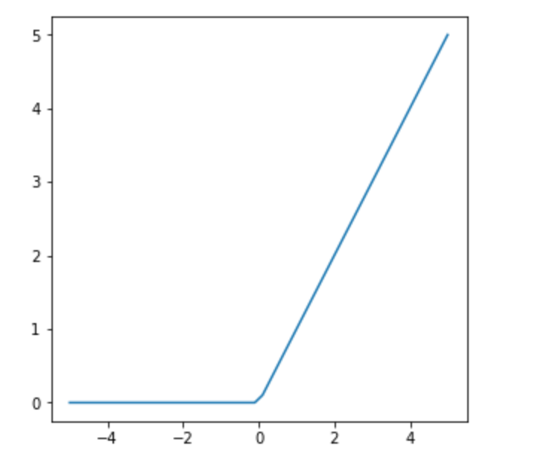
Rectified Linear Units (ReLU)

Slide 38
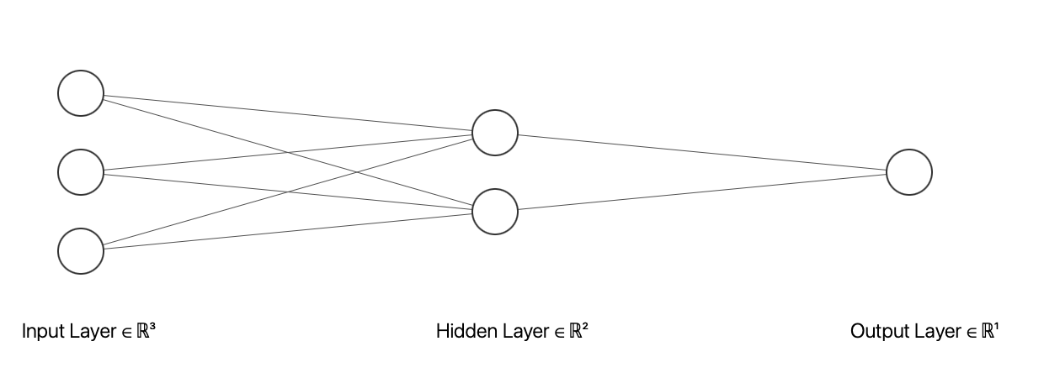
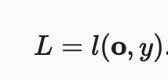



Forward propagation – Loss function (l)

Slide 39

Example – backpropagation
$$o$$
input
$$z$$
$$h$$
$$l$$
1
0.2
y = 0.75 (output)
0.1
0.5
0.5
0.3
loss = (y – o)2
0.3
$$grad_{y_{pred}}$$
$$z=\left(1×0.2\right)+\left(0.5 × 0.1\right)+\left(0.3 × 0.3\right)=0.34$$
$$h= φ\left(z\right)= ReLU\left(z\right)=ReLU\left(0.34\right)=\max\left(0, 0.34\right)=0.34$$
$$o=0.34 × 0.5=0.17$$
$$l={(0.75−0.17)}^{2}=\text{0.3364}$$
$$grad_{y_{pred}}=2 × \left(y_{pred}−y\right)=2 × \left(o−y\right)=2 × \left(0.75 −0.17\right)=1.16$$
$grad_{w2}=0.5 ×grad_{y_{pred}}=0.5 × 1.16=0.58$
$$grad_{h}=0.34 ×grad_{y_{pred}}=0.34 × 1.16=\text{0.3944}$$
$$grad_{w11}=w11 ×grad_{h}=0.2 × 0.394=\text{0.0788}$$
w₁₁ = w₁₁ – (learning_rate * grad_w₁₁)
w₁₂ = w₁₂ – (learning_rate * grad_w₁₂)
w₁₃ = w₁₃ – (learning_rate * grad_w₁₃)
w₂ = w₂ – (learning_rate * grad_w2)

Slide 40

Example

Slide 41

Images a vectors
Using images by flattening the images means overlooking the spatial relation between pixels.
This deeply unsatisfying approach could be a very simple solution in order to feed the resulting one-dimensional vectors through a fully connected MLP or other probabilistic models.

Slide 42



Example – edge detection: kernel

Slide 43




CNN kernels
$$\left(1×0\right)+\left(2×1\right)+\left(4×2\right)+\left(5×3\right)=25$$
$$\left(4×0\right)+\left(5×1\right)+\left(7×2\right)+\left(8×3\right)=43$$
$$\left(3×0\right)+\left(4×1\right)+\left(6×2\right)+\left(7×3\right)=37$$
Two-dimensional cross-correlation operation. The shaded portions are the first output element as well as the input and kernel tensor elements used for the output computation:
(0×0) + (1×1)+ (3×2)+ (4×3)=19.

Slide 44

Padding: example

Slide 45

Pooling
Like convolutional layers, pooling operators consist of a fixed-shape window that is slid over all regions in the input according to its stride, computing a single output for each location traversed by the fixed-shape window (sometimes known as the pooling window).

Slide 46


Compressed notion for LeNet-5

Slide 47


Autoencoder
Source for the middle image: https://uk.mathworks.com/discovery/autoencoder.html

Slide 48
A semi-supervised learning scenario
Encoder
H
{$h_{1}$, …, $h_{n}$}
Decoder
$$Xunlabelled$$
$$Runlabelled$$
Encoder
H
{$h_{1}$, …, $h_{n}$}
$$Xlabelled$$
Classifier
$$Predictions$$

Slide 49

Bayesian Neural Networks**
Source: Sanjay Takur: https://sanjaykthakur.com/2018/12/05/the-very-basics-of-bayesian-neural-networks/

Slide 50


Bayesian Neural Networks**
Source: Jerry Qinghui Yu et al., University of Toronto, https://www.cs.toronto.edu/~duvenaud/distill_bayes_net/public/

Slide 51
ML deployments in real-world settings
The systems are often are used for decision-support by keeping human-in-the-loop.
However, trustworthiness, reliability and robustness of the systems/models must be considered and investigated prior to the deployments.
The users’ perceptions of the system and appropriate training should be also considered.

Slide 52

Hidden technical debt in real-world ML systems
ML Code
Only a small fraction of real-world ML systems is composed of the ML code.
Source: Sculley et al., Hidden Technical Debt in Machine Learning Systems, NeurIPS, 2015.
52

Slide 53
Questions

Slide 54
Q1
What machine learning libraries you have worked with before?

Slide 55
Q2
What is the difference between L1 and L2 norms for regularisation and when you use them.

Slide 56
Q3
If you have a dataset with imbalanced number of samples, how do you deal with this problem?

Slide 57
Q4
If we give you a set of data (imagine imaging data or electronic healthcare records) and ask you to design a machine learning model. Where and how would you start designing your model.

Slide 58
Q5
If you are given a dataset how do you decide which model would be the most efficient model to solve your problem?

Slide 59
Q6
If you are given a dataset to cluster. How do you decide what number of clusters would be the most suitable for the dataset?

Slide 60
Q7
How would you make sure the model that you have designed is not overfitted?

Slide 61
If you have any questions
Please feel free to come and see me (9th Floor, Sir Michael Uren Research Hub, White City Campus) or email (p.barnaghi@imperial.ac.uk).

